Slide 1
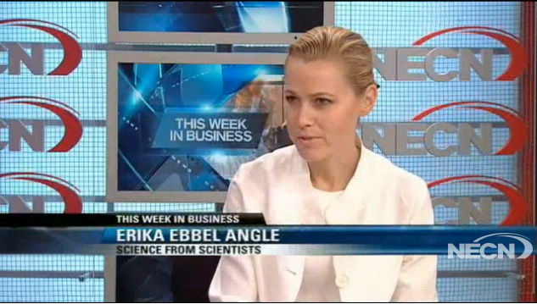
TWIB: Science from Scientists (July 21, 2013)
Erika Ebbel Angle discusses program aimed at exciting young boys and girls about science. (Click image for video)
Notes:
http://www.necn.com/pages/video?PID=DN8Q_LVnBI_Yzjx9CztlY7kWVQqKqQKQ

